Slide 1
Integrating with MySQL
https://docs.google.com/presentation/d/1ojUToka1KXL7JepA_ilBeVj3fIKlT6ny4psQKVAvg4E/edit?usp=sharing

Slide 2
To copy the files from repository to your computer
There are a couple of possible ways to copy the files from the repository.
Run git desktop, you can find it here: https://desktop.github.com/
Copy the repository as a zip file, download the zip file and unzip it on your local computer.
Open the files individually and copy them to your local computer.
It is up to you, to find the best way to do this. The desktop is a simple process for managing github repositories.

Slide 3

Using the Github desktop tool
You might find this video helpful.
The following slides after this one are just showing what the URL might look like for the repo that is created in your class repository when you accepted the invite.

Slide 4

Another Github Desktop tutorial
Here is another video that you might find helpful with github desktop.

Slide 5

Install Github Desktop
Install the github desktop version that will work on your computer. After installation, run the application, you should see the window like the one to the right ->

Slide 6
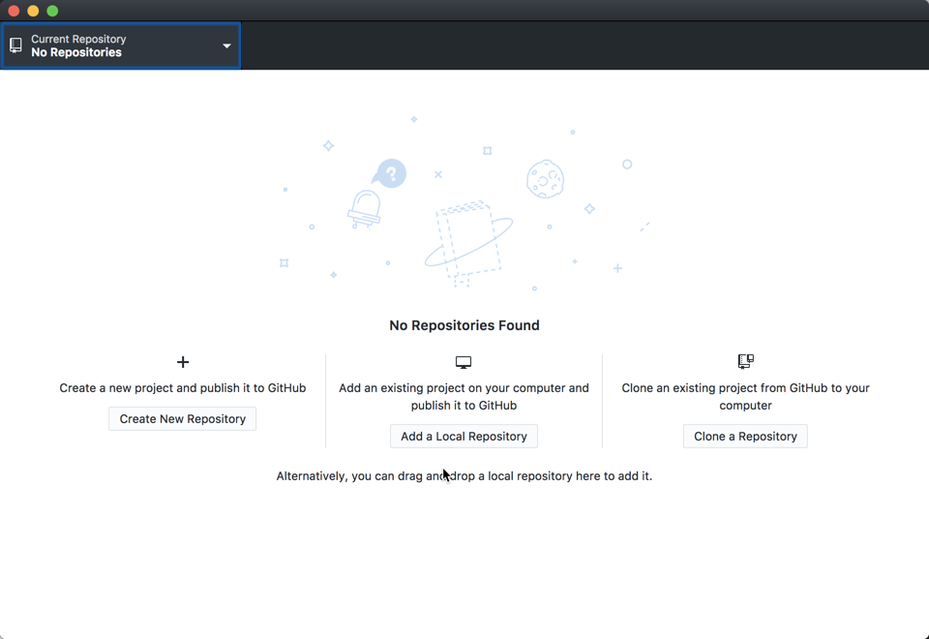
After signing in to Github desktop
After you sign into github, the desktop application will ask for a repository to clone or create.

Slide 7
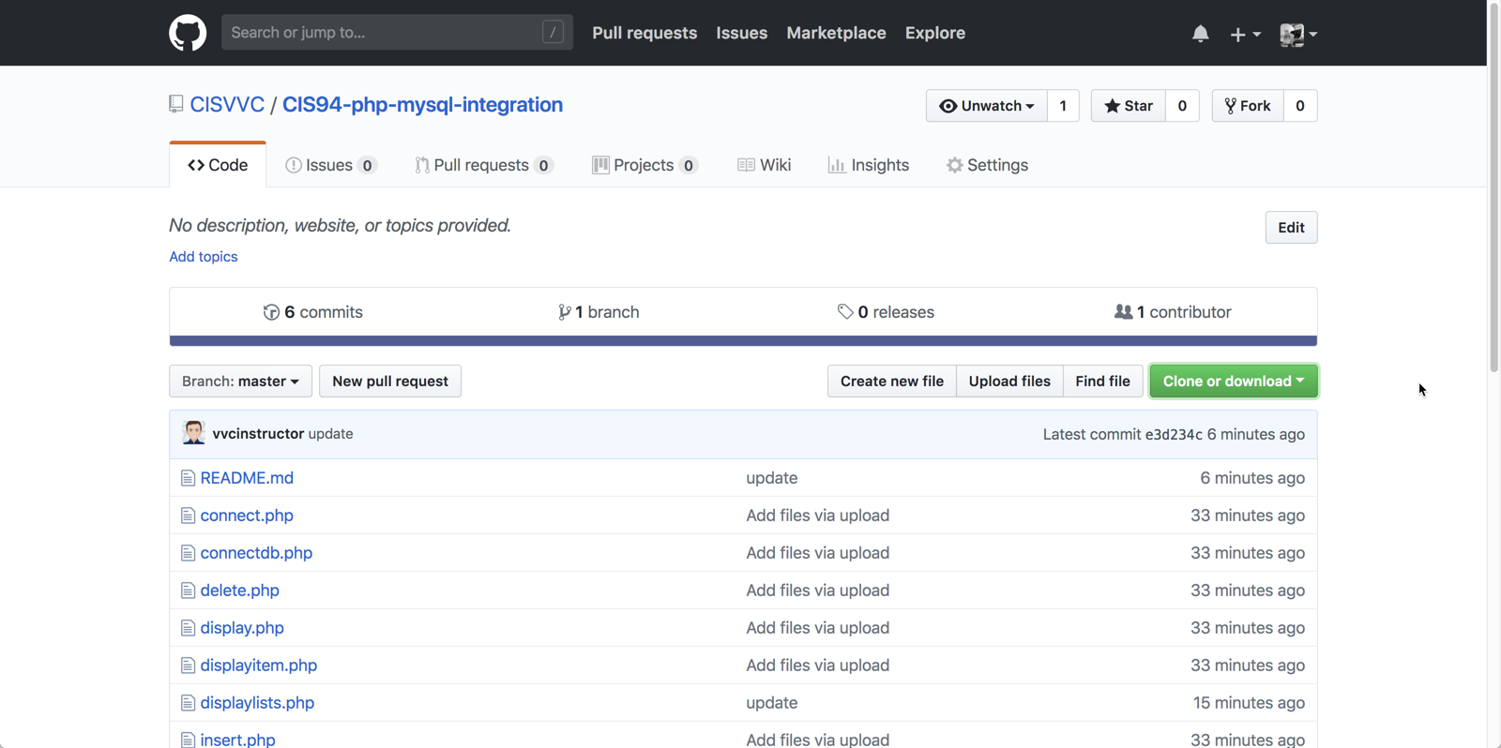
Get the github URL

Slide 8
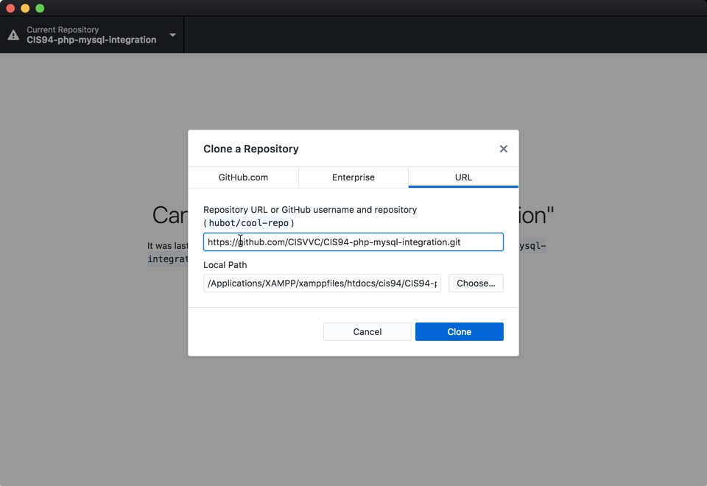
Cloning the repository

